Slide 1
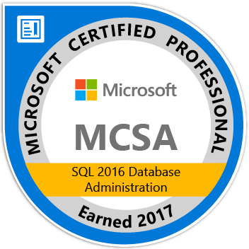

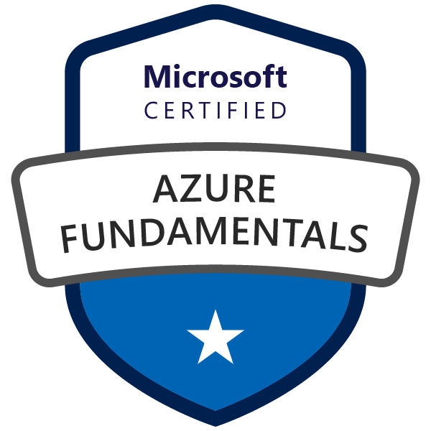

Azure certification paths
Christian Araujo
Regional SQL Architect

Slide 2
Vale la pena certificarse?

Slide 3
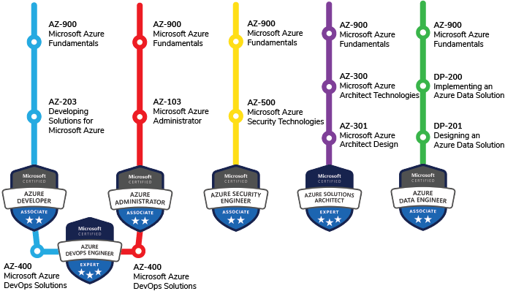

Slide 4
Paths nuevos
Microsoft Azure Developer – AZ-203
Microsoft Azure AI Engineer Associate – AI-100
DP-100 Designing and Implementing a Data Science solution
Microsoft Azure Security Engineer Associate – AZ-500

Slide 5

Training?

Slide 6
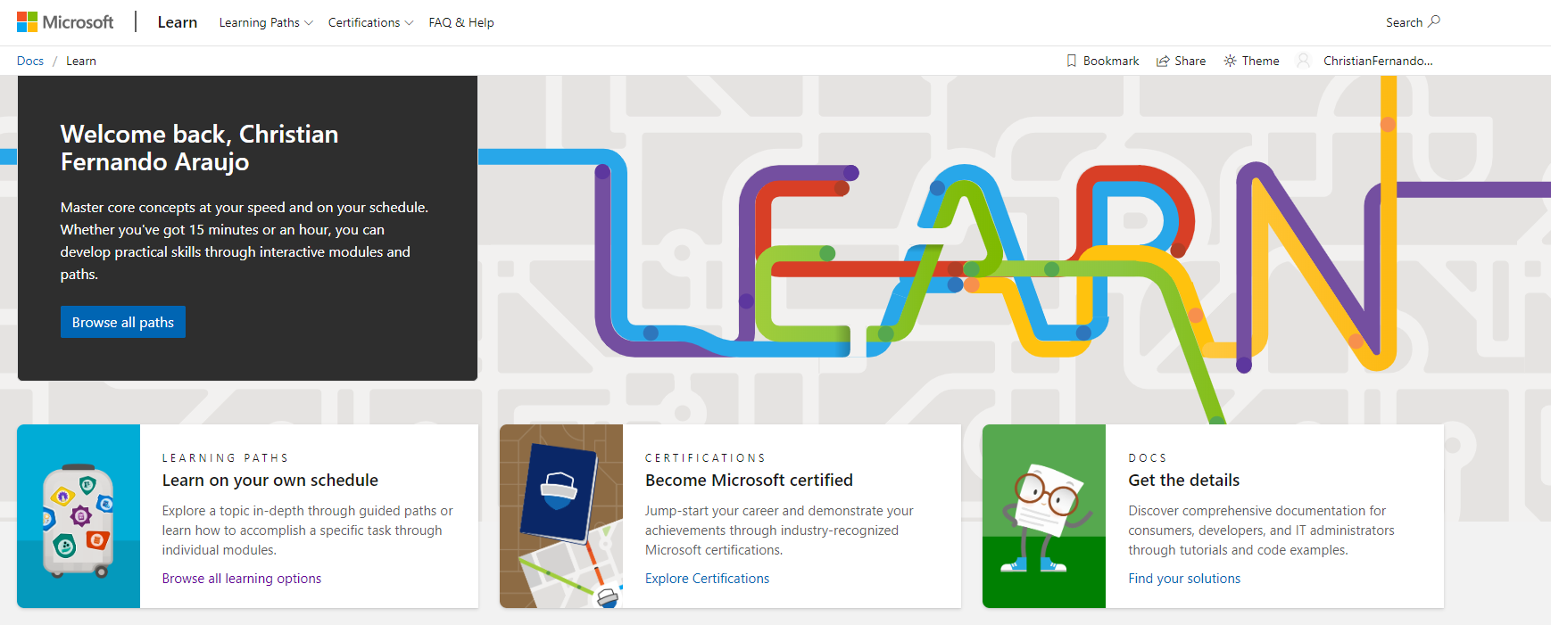
Materials

Slide 7


Materials

